Slide 1


CricLens
An Intelligent IPL Analytics & Decision Support Platform
From Every Ball to Every Insight

Slide 2
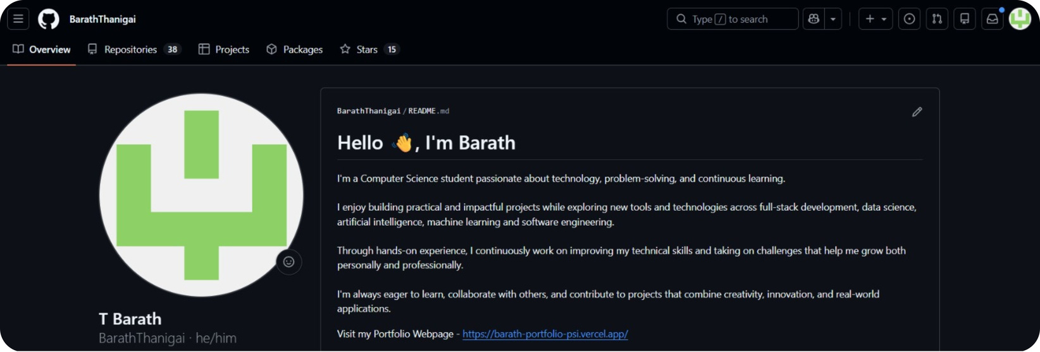
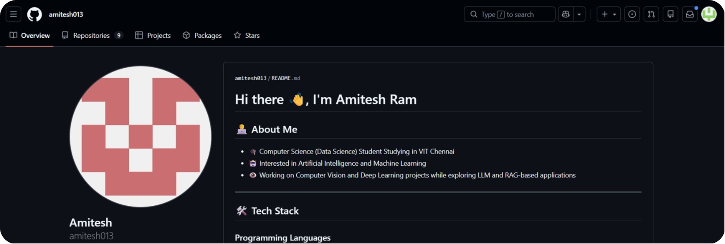
Title & Team Details
GitHub Profiles
Team Members
Amitesh Ram
24BDS1030
Barath T
24BDS1178
Project
CricLens — IPL Analytics & Decision Support Platform
Course Submission
Big Data Science · VIT University

Slide 3

Motivation
The Problem
Why IPL?
Massive, Underutilized Data
Fragmented Intelligence
Rich, Structured Data
T20 Strategic Complexity
19 years, 250+ matches, 150K+ balls annually — yet insights remain buried and inaccessible
Stats scattered across platforms with no way to correlate player, team, and venue data meaningfully
Ball-by-ball records, player stats, and venue conditions — publicly available and well-documented
The format demands split-second tactical decisions where analytics delivers measurable edge
Intuition Over Evidence
No Unified Source of Truth
400M+ Global Fans
High-Stakes Business Impact
Deeper insights drive engagement, viewership, and commercial value at an enormous scale
Coaches and analysts rely on gut feel rather than structured, data-driven decision support
Coaches, analysts, and fans each need one authoritative platform — and none currently exists
Teams invest millions per season — superior analytics translates directly to competitive advantage

Slide 4

Project Objectives
A rigorous data science pipeline — from raw ball-by-ball records to an interactive decision support platform.
Analytics Modules
System Architecture Pipeline
Player Intelligence
Consistency analysis, phase-wise performance, custom impact score
Team Intelligence
Win probability modeling, toss analysis, chase analysis
Venue Intelligence
Ingest & Clean
Exploratory
Feature Engineering
Statistical Modeling
Pitch behaviour patterns, average scores & variance, toss influence
Predictive Analytics
Match prediction, player form forecasting, player clustering

Slide 5



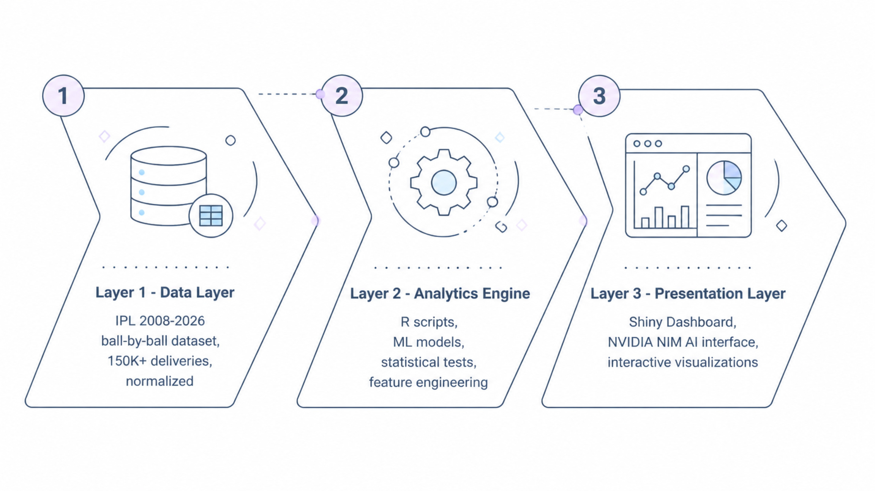
Overall Project Diagram
The Dataset
Technology Stack
Key Use Cases
IPL 2008–2026 · 250+ matches · 150K+ deliveries · Player metrics · Venue conditions · Match outcomes · Cleaned & normalized
Core: R — dplyr, tidyr, ggplot2, plotly, caret, randomForest, forecast
Dashboard: Shiny reactive web app
AI Interface: NVIDIA NIM API — NL to R function mapping
Death Overs Specialist: Phase-wise ranked list with strike rate & impact index
Venue Head-to-Head: Radar chart + statistical significance
Match Outcome Prediction: ML win probability with confidence intervals

Slide 6

Deliverables
Core Deliverables
Expected Outcomes
01
Fully functional analytics platform with predictive models and interactive dashboards
Data-driven decision support for teams, coaches, and analysts — backed by statistical rigor
Cleaned IPL Dataset
2008–2026, normalized and validated
02
Future Roadmap
Analytics Engine & ML Models
Reproducible R scripts with validation metrics
Real-time match analytics and mobile application
03
Multi-league expansion — BBL, PSL, and international formats
Interactive Shiny Dashboard
Real-time exploration, filtering, and visual discovery
Fantasy XI recommendation engine powered by player clustering models
04
Natural Language Query Assistant
Conversational interface powered by NVIDIA NIM
05
Technical Report
Full documentation with model validation and methodology

